Slide 1
Personal Time Manager Application
Developed and Built by Ben Molloy

Slide 2
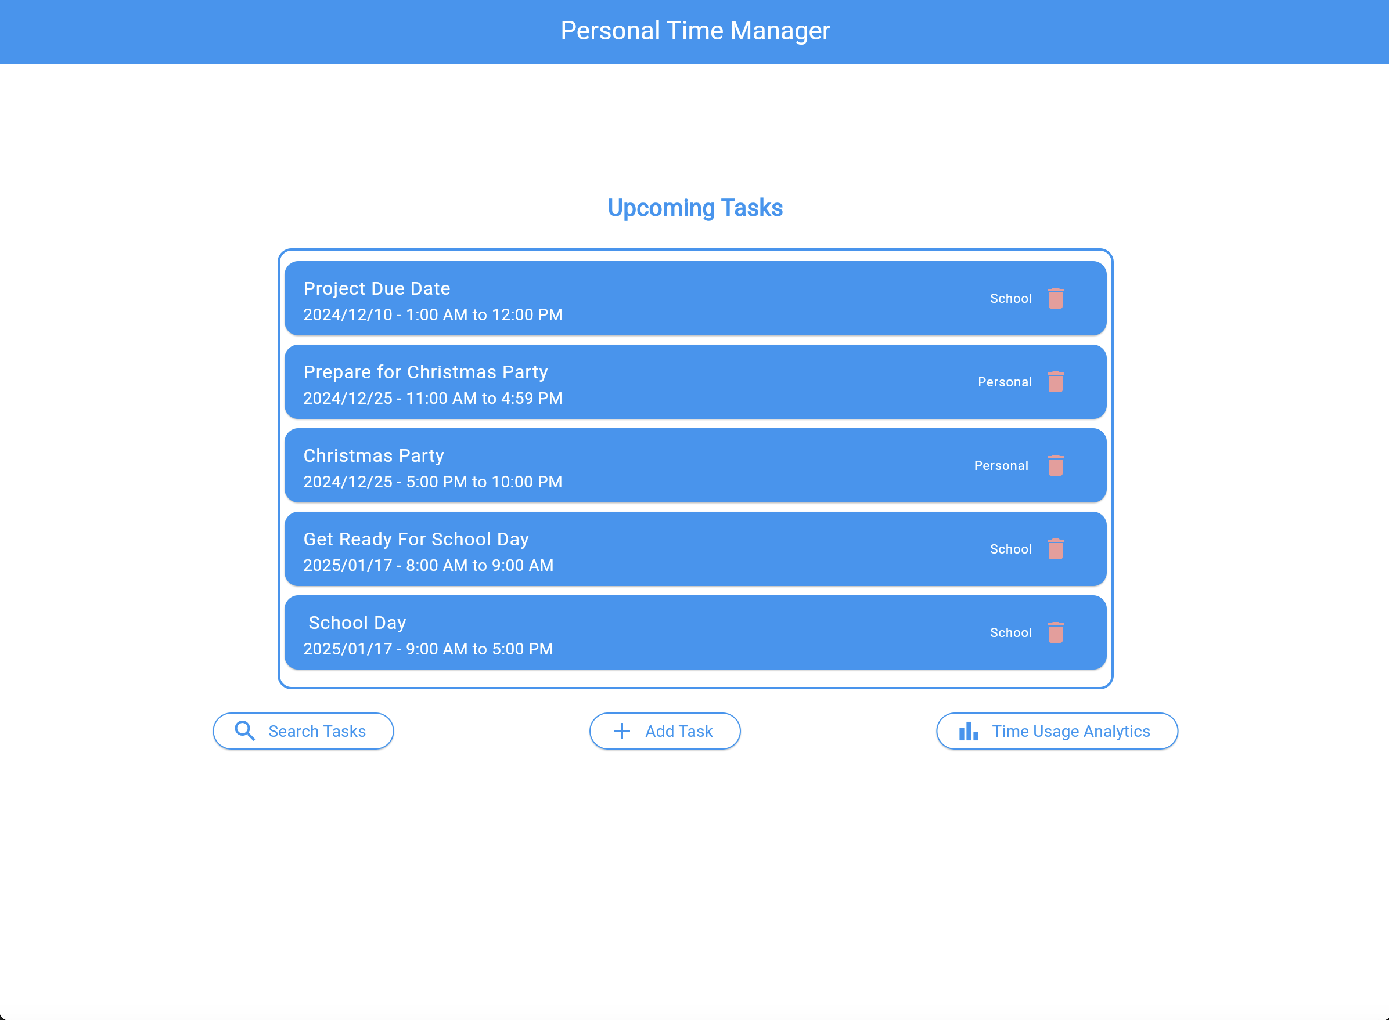
Purpose of Application
Simplifies task management for busy individuals.
Helps you organize, prioritize, and track your daily tasks efficiently.
Provides clear insights into how your time is spent with detailed analytics.
Built to enhance productivity and reduce stress by keeping everything in one place.

Slide 3
Features
The following features are what makes this application shine above all other task management applications.
Upcoming Events
Add Tasks
Preview Task As They Are Built
Query Events By Date, Tag, and Task
Query Events By Date Range
Delete Tasks
Generate Quick Time Report
Analyze Overall Time Usage

Slide 4
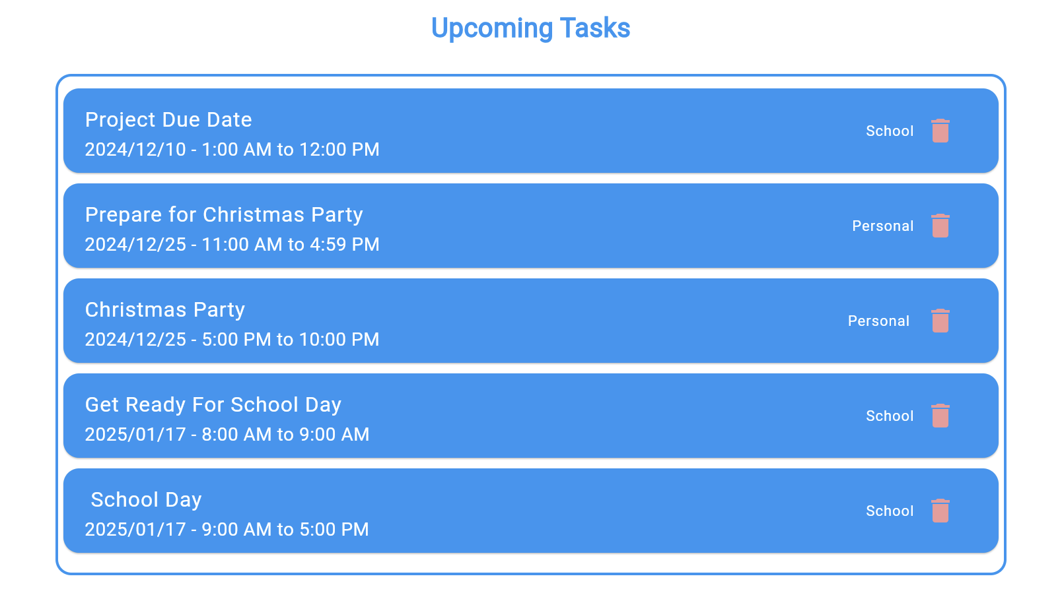
Upcoming Events
Clear View of Priorities: Quickly see your top 5 upcoming tasks, ensuring nothing important is overlooked.
Organized Display: Tasks are sorted by date and time for easy navigation.
Efficient Management: Delete tasks directly from the list with a single tap.

Slide 5
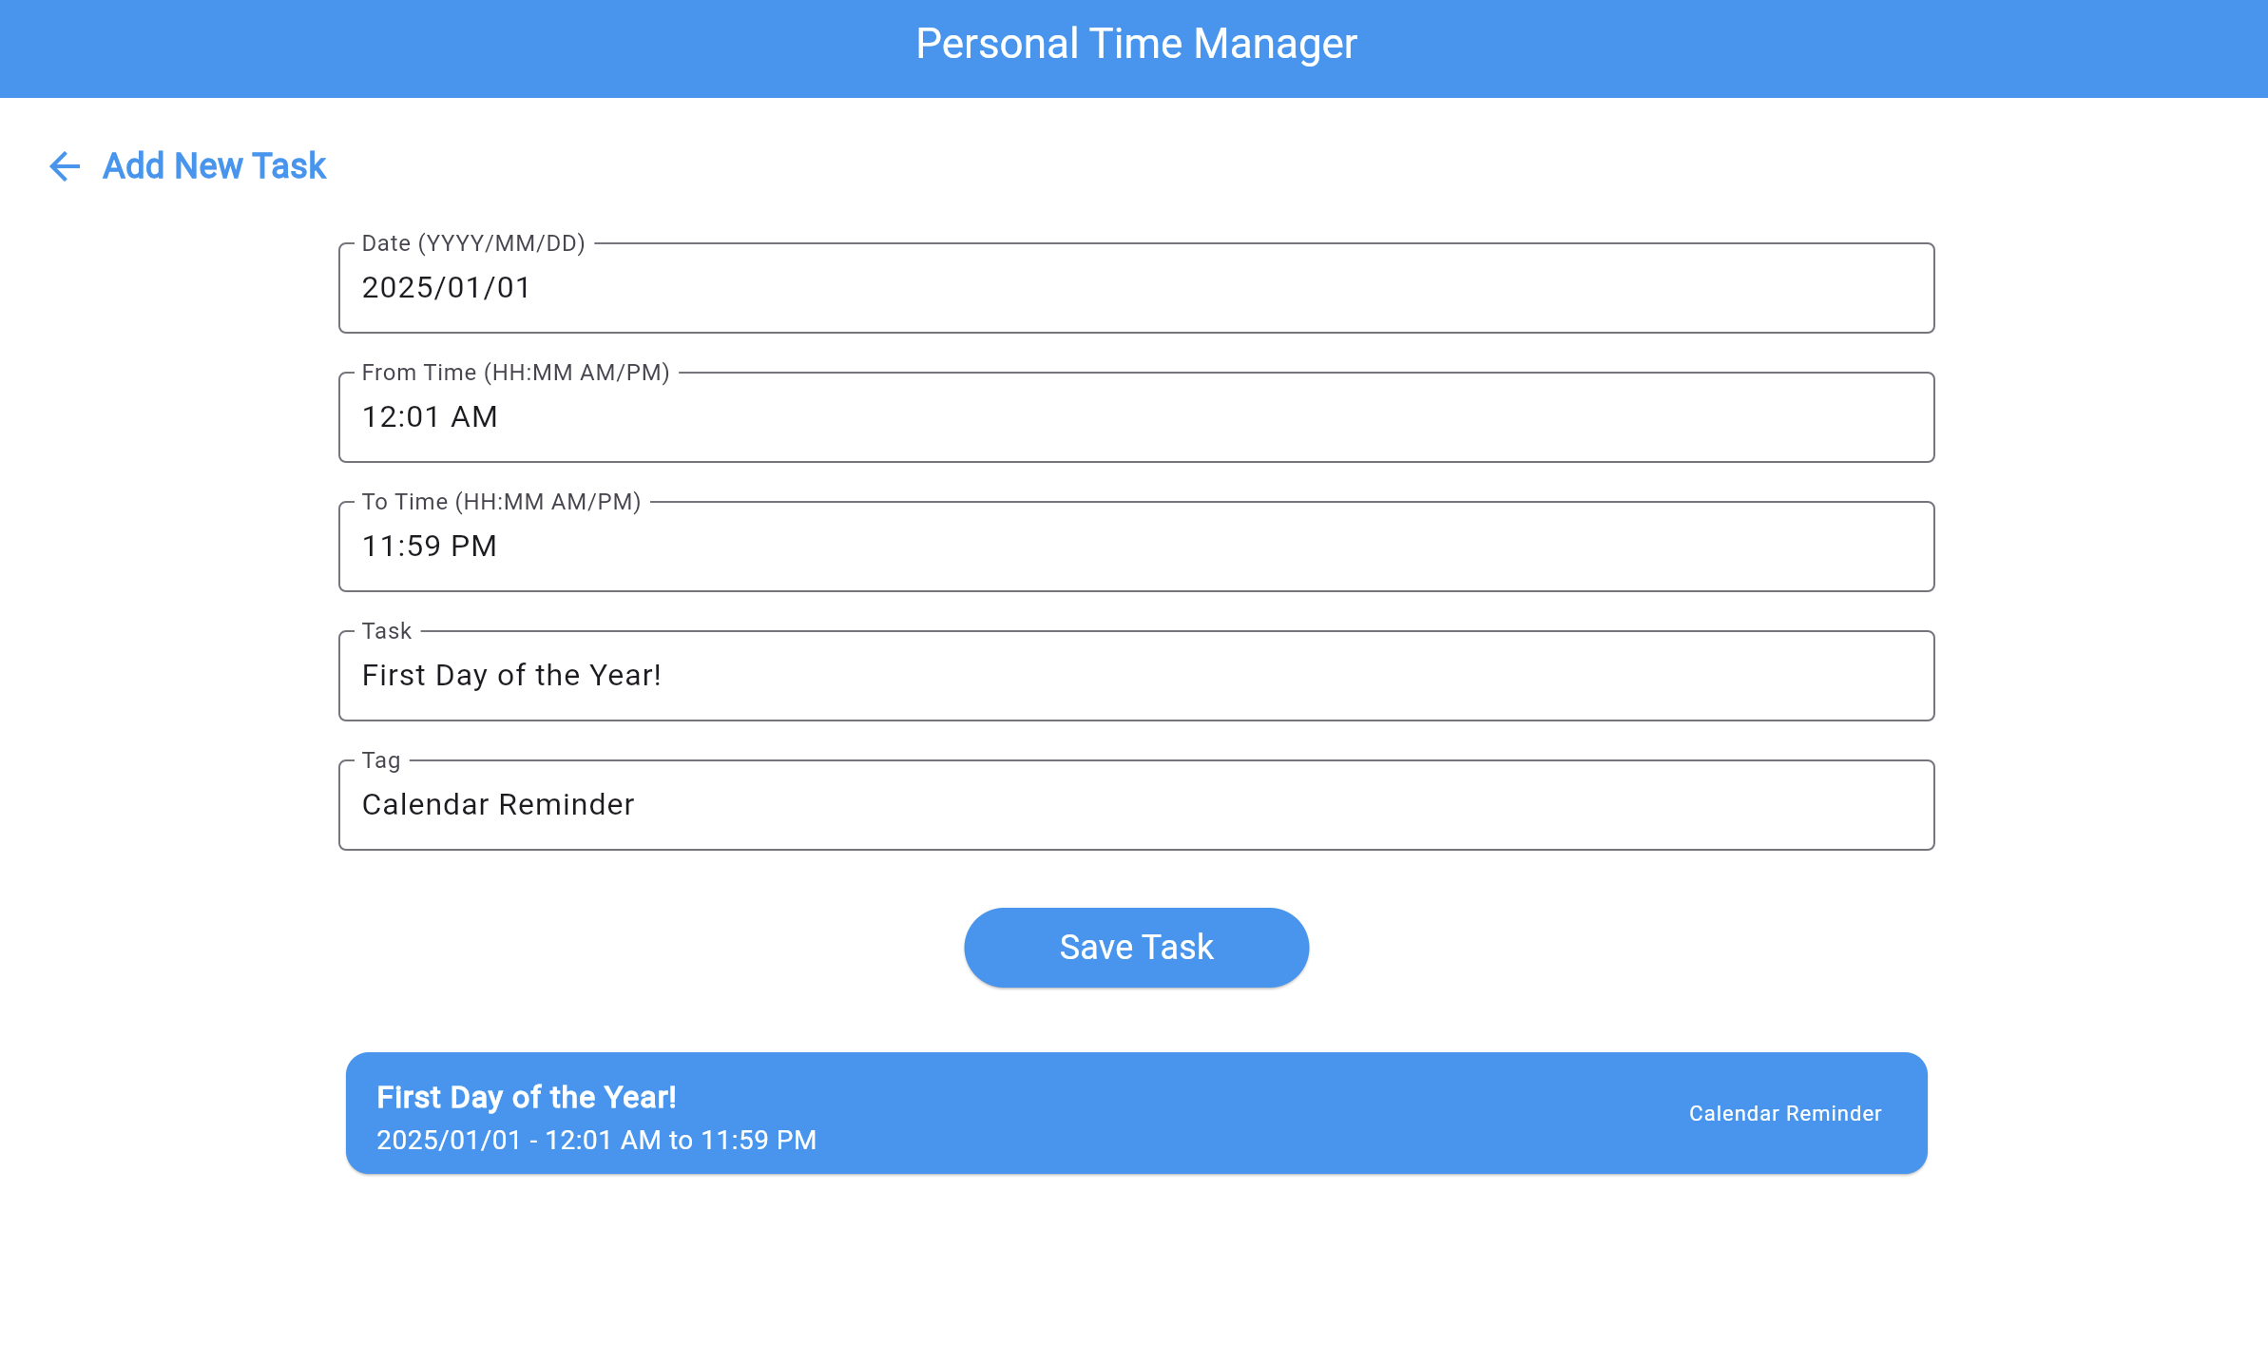
Add Tasks
Simple Input Fields: Add tasks with date, time, name, and tag for easy organization.
Customizable Tags: Categorize tasks to match your priorities (e.g., Work, Personal, School).
Quick Save: Save tasks in seconds with a clean and intuitive interface.
Input Error Checking: Error checking on the inputs prevent you from accidentally putting in an incorrect input.
Preview New Tasks: Preview new tasks LIVE as they are being created in the preview box.

Slide 6
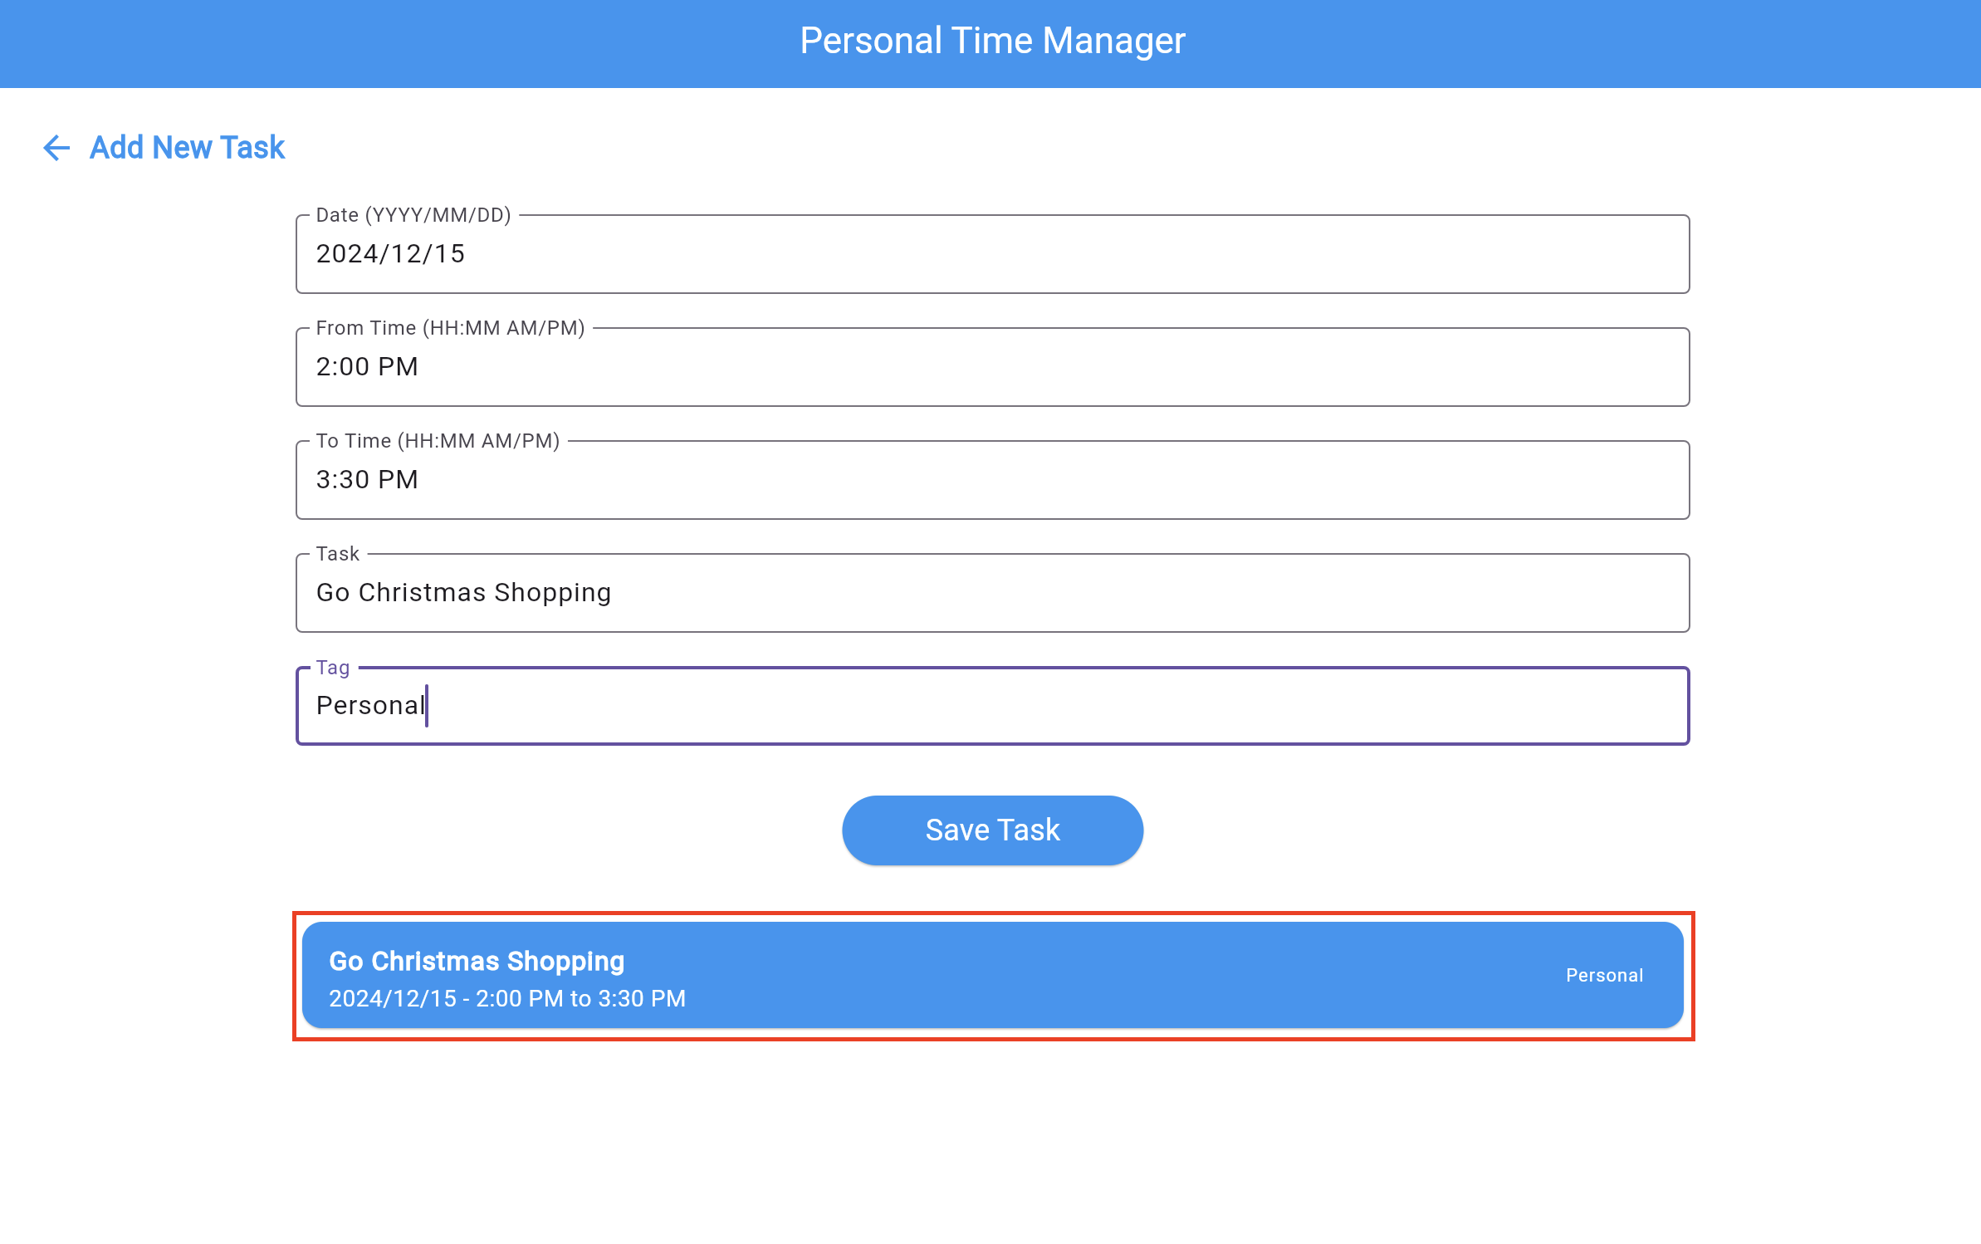
Preview Task As They Are Built
Live Updates: View your task details immediately as you input them.
Error-Free Planning: Ensure accuracy by reviewing tasks before saving them.
Simplified Workflow: Avoid confusion with a clear preview of your task.

Slide 7
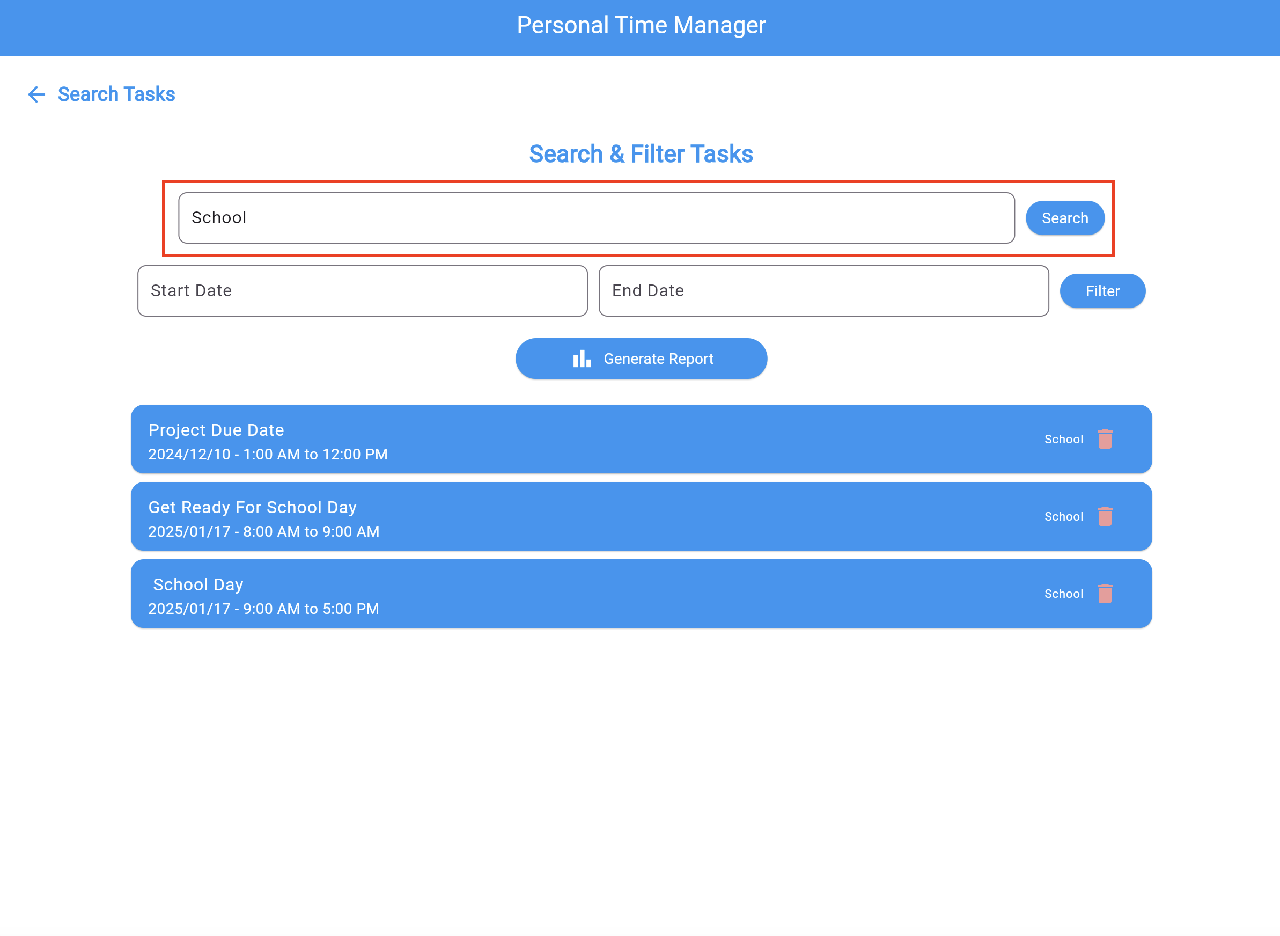
Query Events By Date, Tag, and Task
Powerful Search Tools: Filter tasks by date, tag, or specific task names.
Stay Organized: Quickly locate important events without scrolling through lists.
Customizable Views: Tailor your search to match your schedule and priorities.

Slide 8
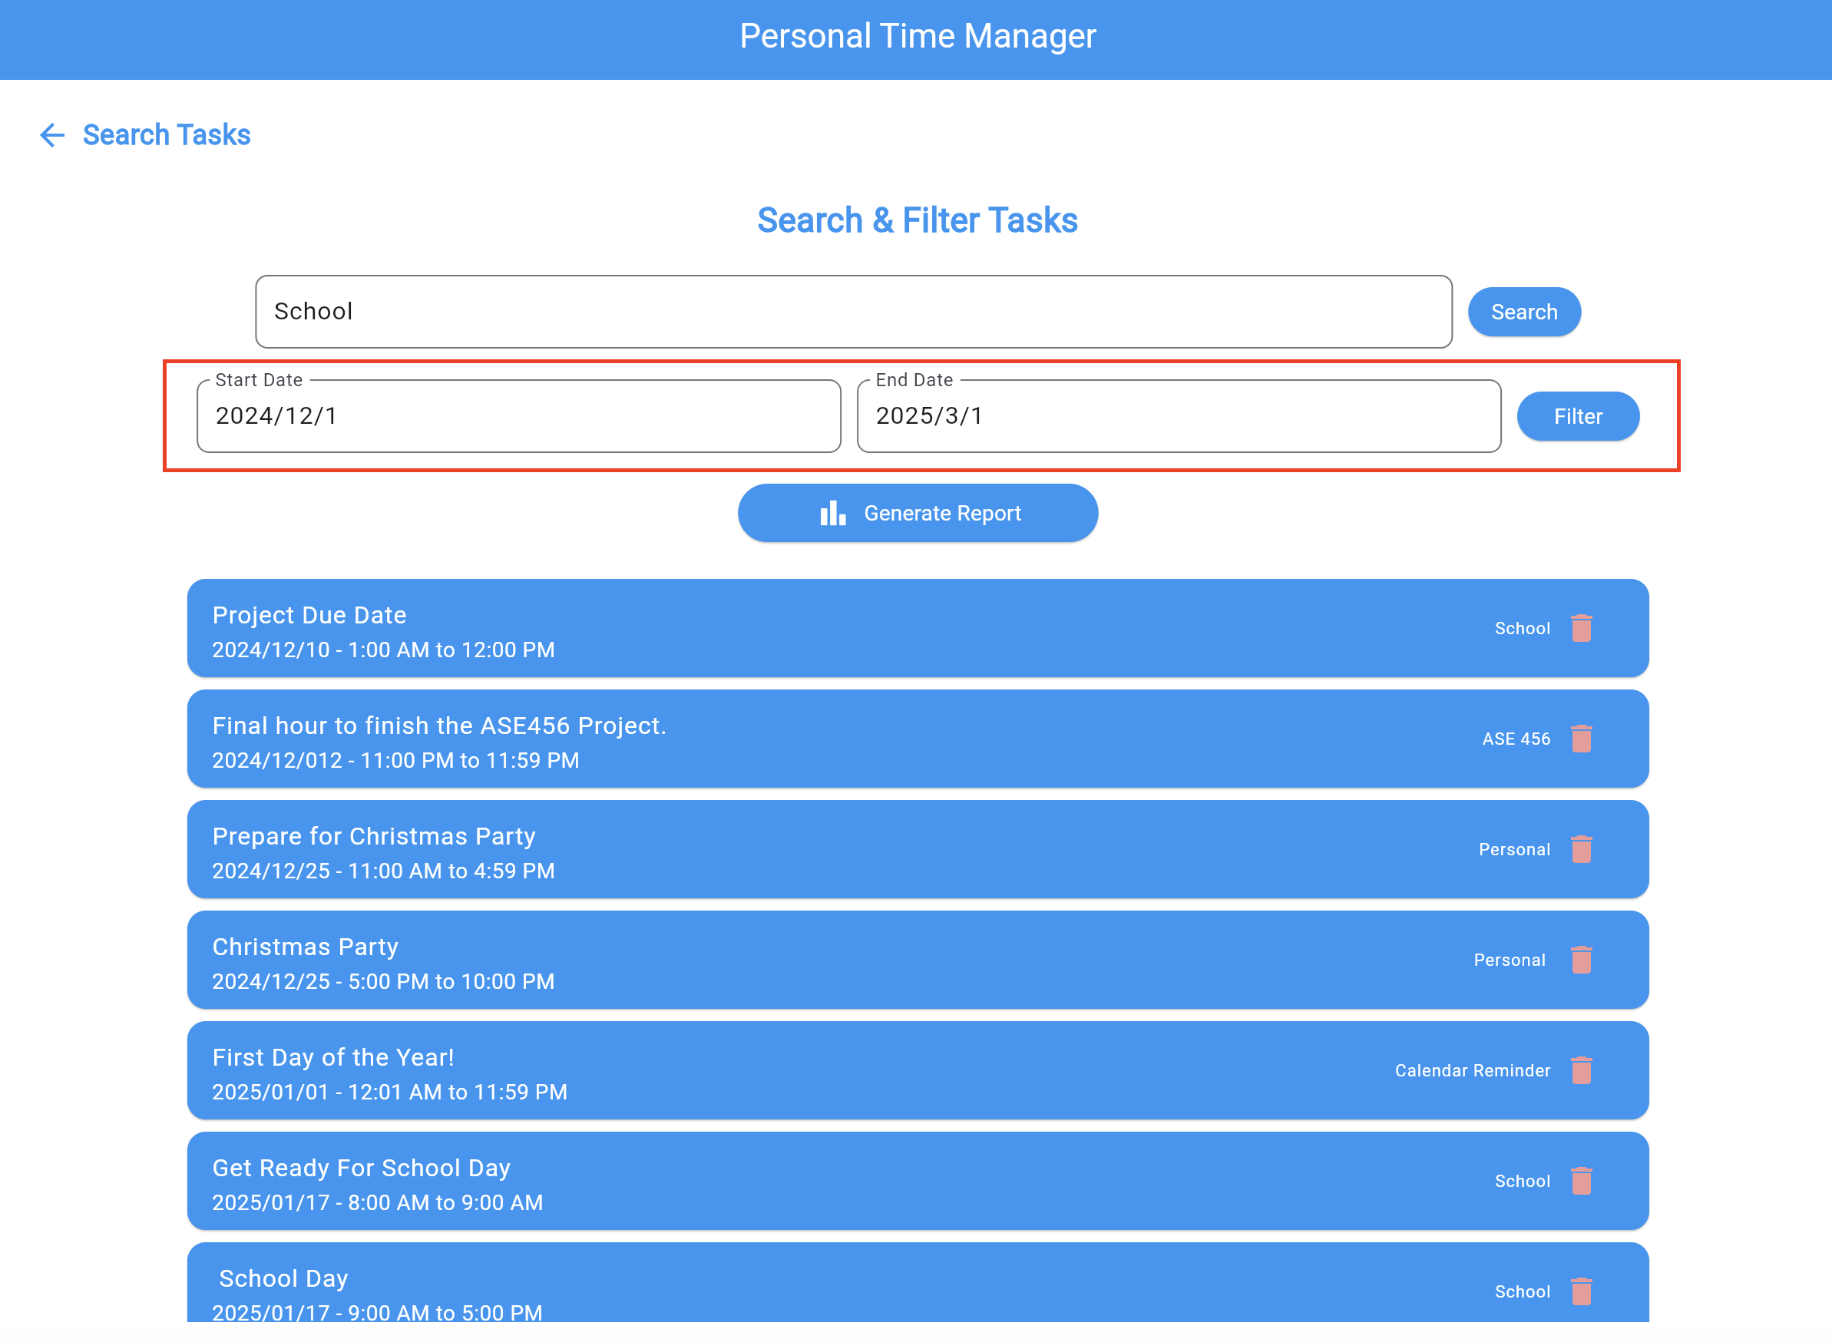
Query Events By Date Range
Targeted Queries: Search for tasks within a specific date range.
Plan Effectively: Perfect for reviewing past events or planning upcoming schedules.
Streamline Workflow: Save time by narrowing down to the exact data you need.

Slide 9
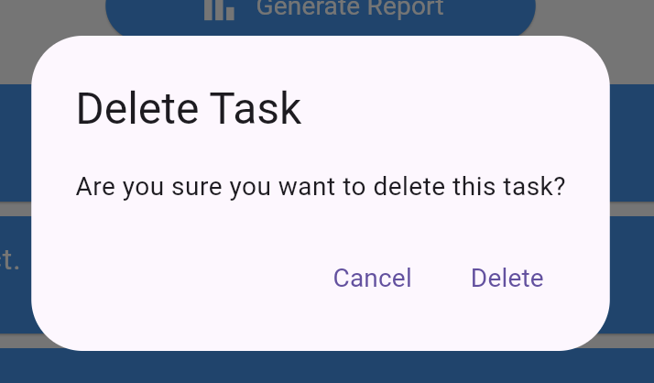
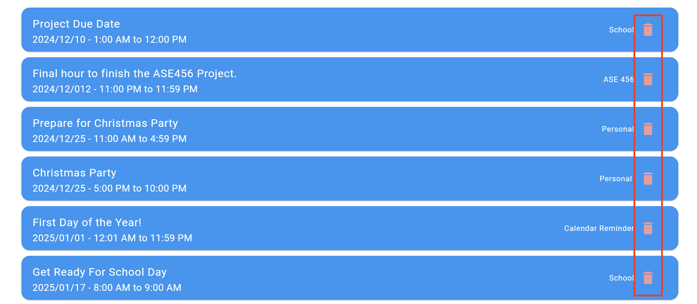
Delete Tasks
Quick Removal: Delete outdated or unnecessary tasks with just a tap.
Confirmation Prompt: Avoid accidental deletions with a secure confirmation dialog.
Stay Organized: Maintain a clutter-free task list for better focus and efficiency.

Slide 10
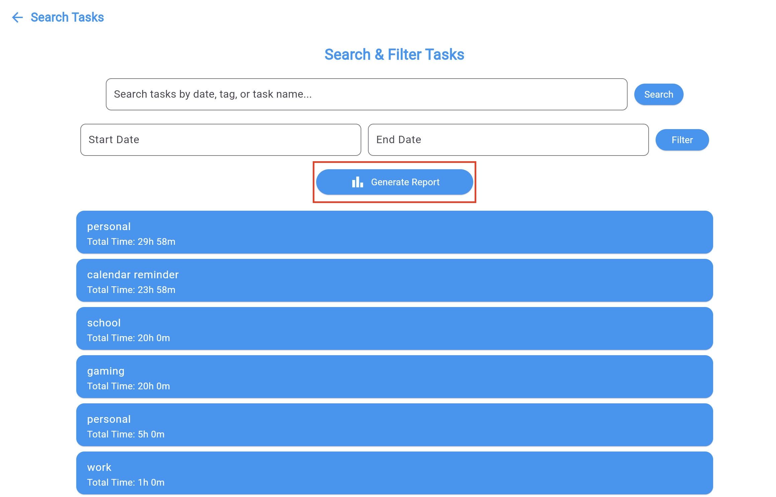
Generate Quick Time Report
One-Click Reports: Quickly generate time usage reports for tasks.
Customizable Date Range: Analyze your schedule within specific timeframes.
Actionable Insights: Understand how your time is allocated to improve productivity.

Slide 11
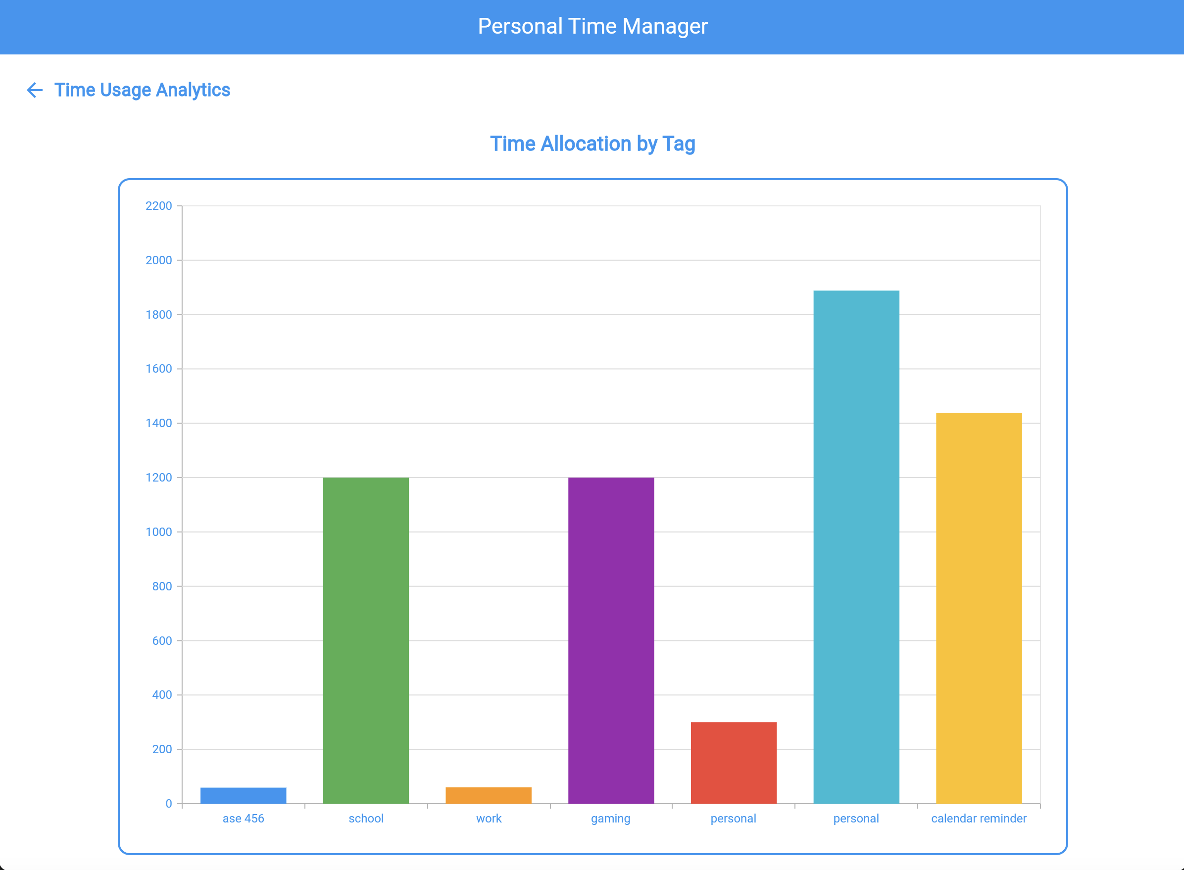
Analyze Overall Time Usage
Comprehensive Insights: Gain a clear picture of how your time is distributed across tasks.
Interactive Analytics: Explore detailed graphs to identify trends and improve productivity.
Data-Driven Decisions: Make informed adjustments to your schedule with visual feedback.

Slide 12
Why You Should Invest
Proven Need: Time management is a universal challenge which my app solves it perfectly.
User Centric Design: Built with simplicity and productivity in mind.
Market Potential: Scalable for individual users, teams, and businesses.
Innovative Features: Combines task management, analytics, and reporting in one platform.

